Slide 1



Why don't people seem to be able to diagnose problems these days?
Richard Fennell
Chief Technology Officer (Black Marble) Microsoft MVP (Developer Technologies) FBCS CEng (BCS)

Slide 2
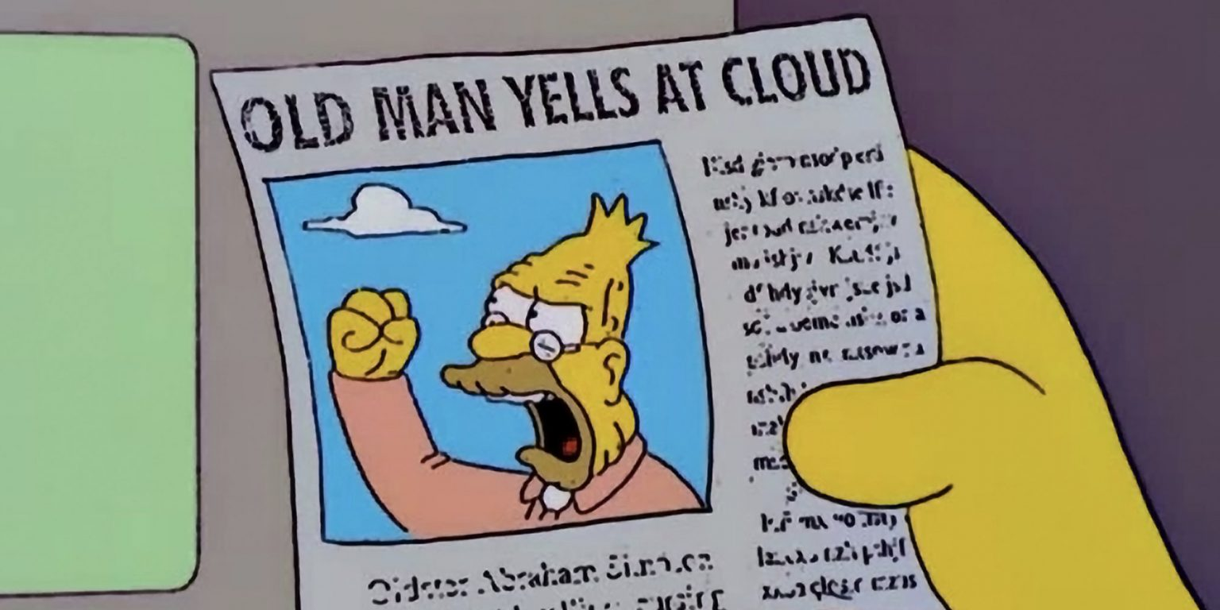
Notes:
The danger is this session is me, an old man, shouting at clouds and complaining about the youth of today – but I hope not

Slide 3

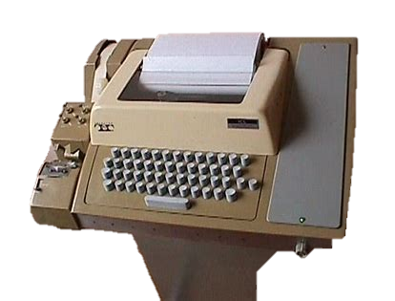
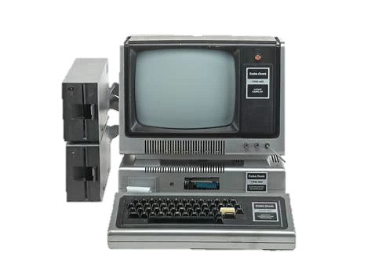
A bit of my history
Notes:
Did 0 level Computer Science
First year it was taught 1982
Very ‘concept focus’, flow charts, system thinking, logic gates, how a computer works
Programming on 5 Hole punch paper tape (North Staffs Poly) and later a single Tandy TRS 80 (for 30 students)
4 years later course had become ICT on BBC Micro – so a narrow window of this style of teaching

Slide 4
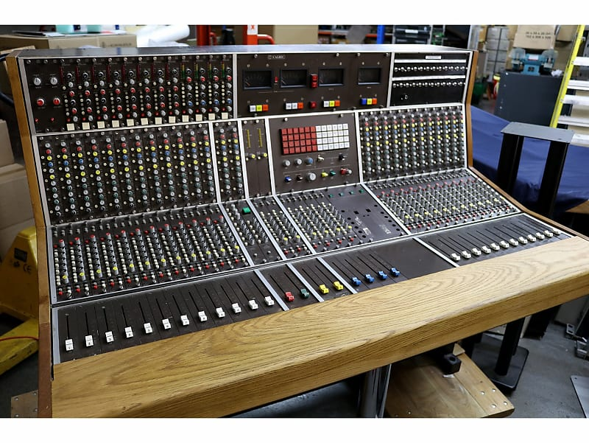
Notes:
A few years in electronics
Electronic Test in Telephone and Pro Audio
Remember this was pre ‘everything is a computer’

Slide 5

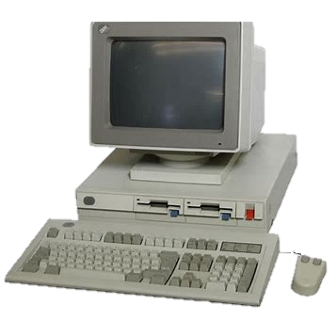
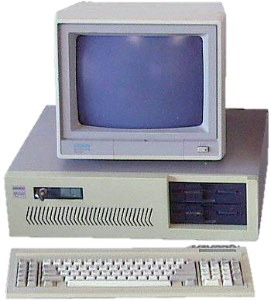
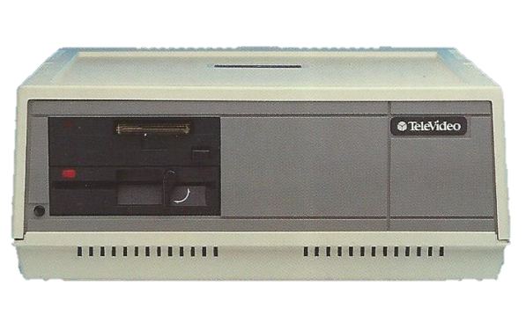
Life in a 1990’s PC dealership
Notes:
PC Dealer 1990s – lots of small companies
PC AT - ISA set IRQ And DMA addresses with jumpers
IBM PS2 – big step for as MCA (Microchannel)? Auto assigned link a predecessor of PCI
Start of LANs – Televideo 8 users via a serial based network (Lots soldering cables) and 10Mb disk and Infoshare/Netware
IT for me was as much electronics as software
The fact I came from electronic test background which was a great help

Slide 6


Notes:
Today systems are just plug and play – a black box
Most IT staff I contend, barely consider, or know, how the kit hang together? (Exception is PC Gamers)

Slide 7
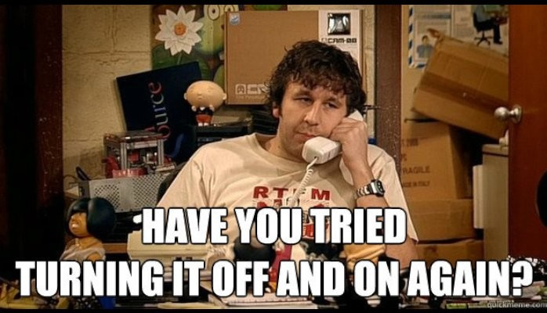
Notes:
This is seen by the most common IT meme, it true because it works
Intermittent issues to get things working
Reboot works to fix state memory leak issues
Cloud computing encourage black boxes
throw away create me a new one
not all bad, as we build up cruft on updating PCs, but does not encourage root cause analysis
Cattle not kittens (or maybe also use the chickens analogy extension)
The quick reboot means there is no root cause analysis
But are we doing ourselves a disservice?

Slide 8

For any problem, follow the process…
Collect the Evidence
Analyse the Evidence
Locate the Fault
Determination and Removal of the Cause
Rectification of the Fault
Check the System
Notes:
Critical thinking
Focus on what does not working
And what you know
If you don’t have the information, why not?
Poor design
Poor telemetry
But mention But how different people do this can vary greatly in how they think and approach problems
Worth a diversion into concrete or Intuitive thinker, story from PC dealer days

Slide 9
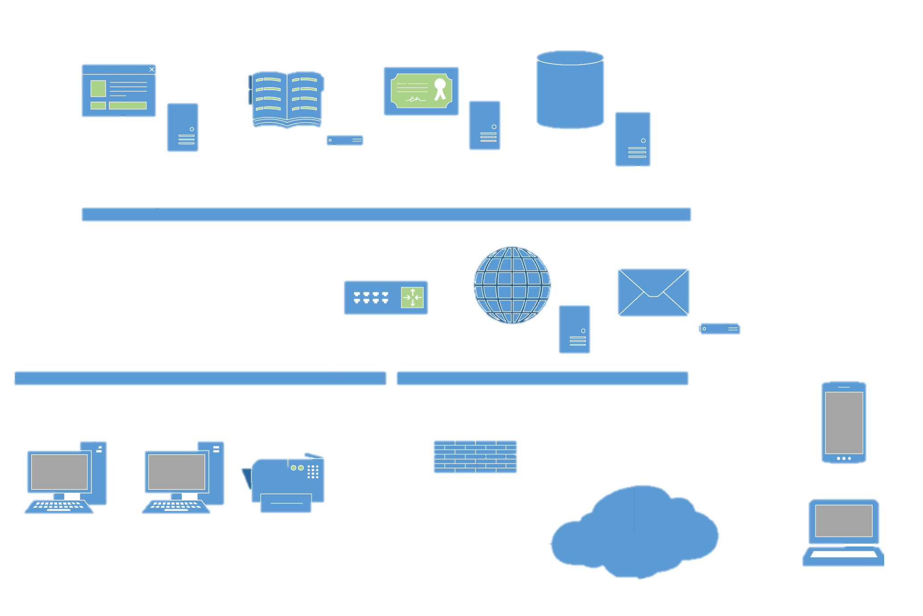


Consider the whole system
Externals
PC Hardware
Operating System
Users
Framework
Application
Network Configuration
Network Hardware
Notes:
Don’t focus on just the application
Consider the whole system including the uses
Work down the stack until you find something that works

Slide 10

How can our habits help us to diagnose problems more efficiently?

Slide 11
What is your system meant to do?
Test Plan & Results
Version 1.0
Specification
Version 1.0
User Manual
Version 1.0
Notes:
What is it meant to do
Is there a spec – requirements
Formal tests
User manual

Slide 12


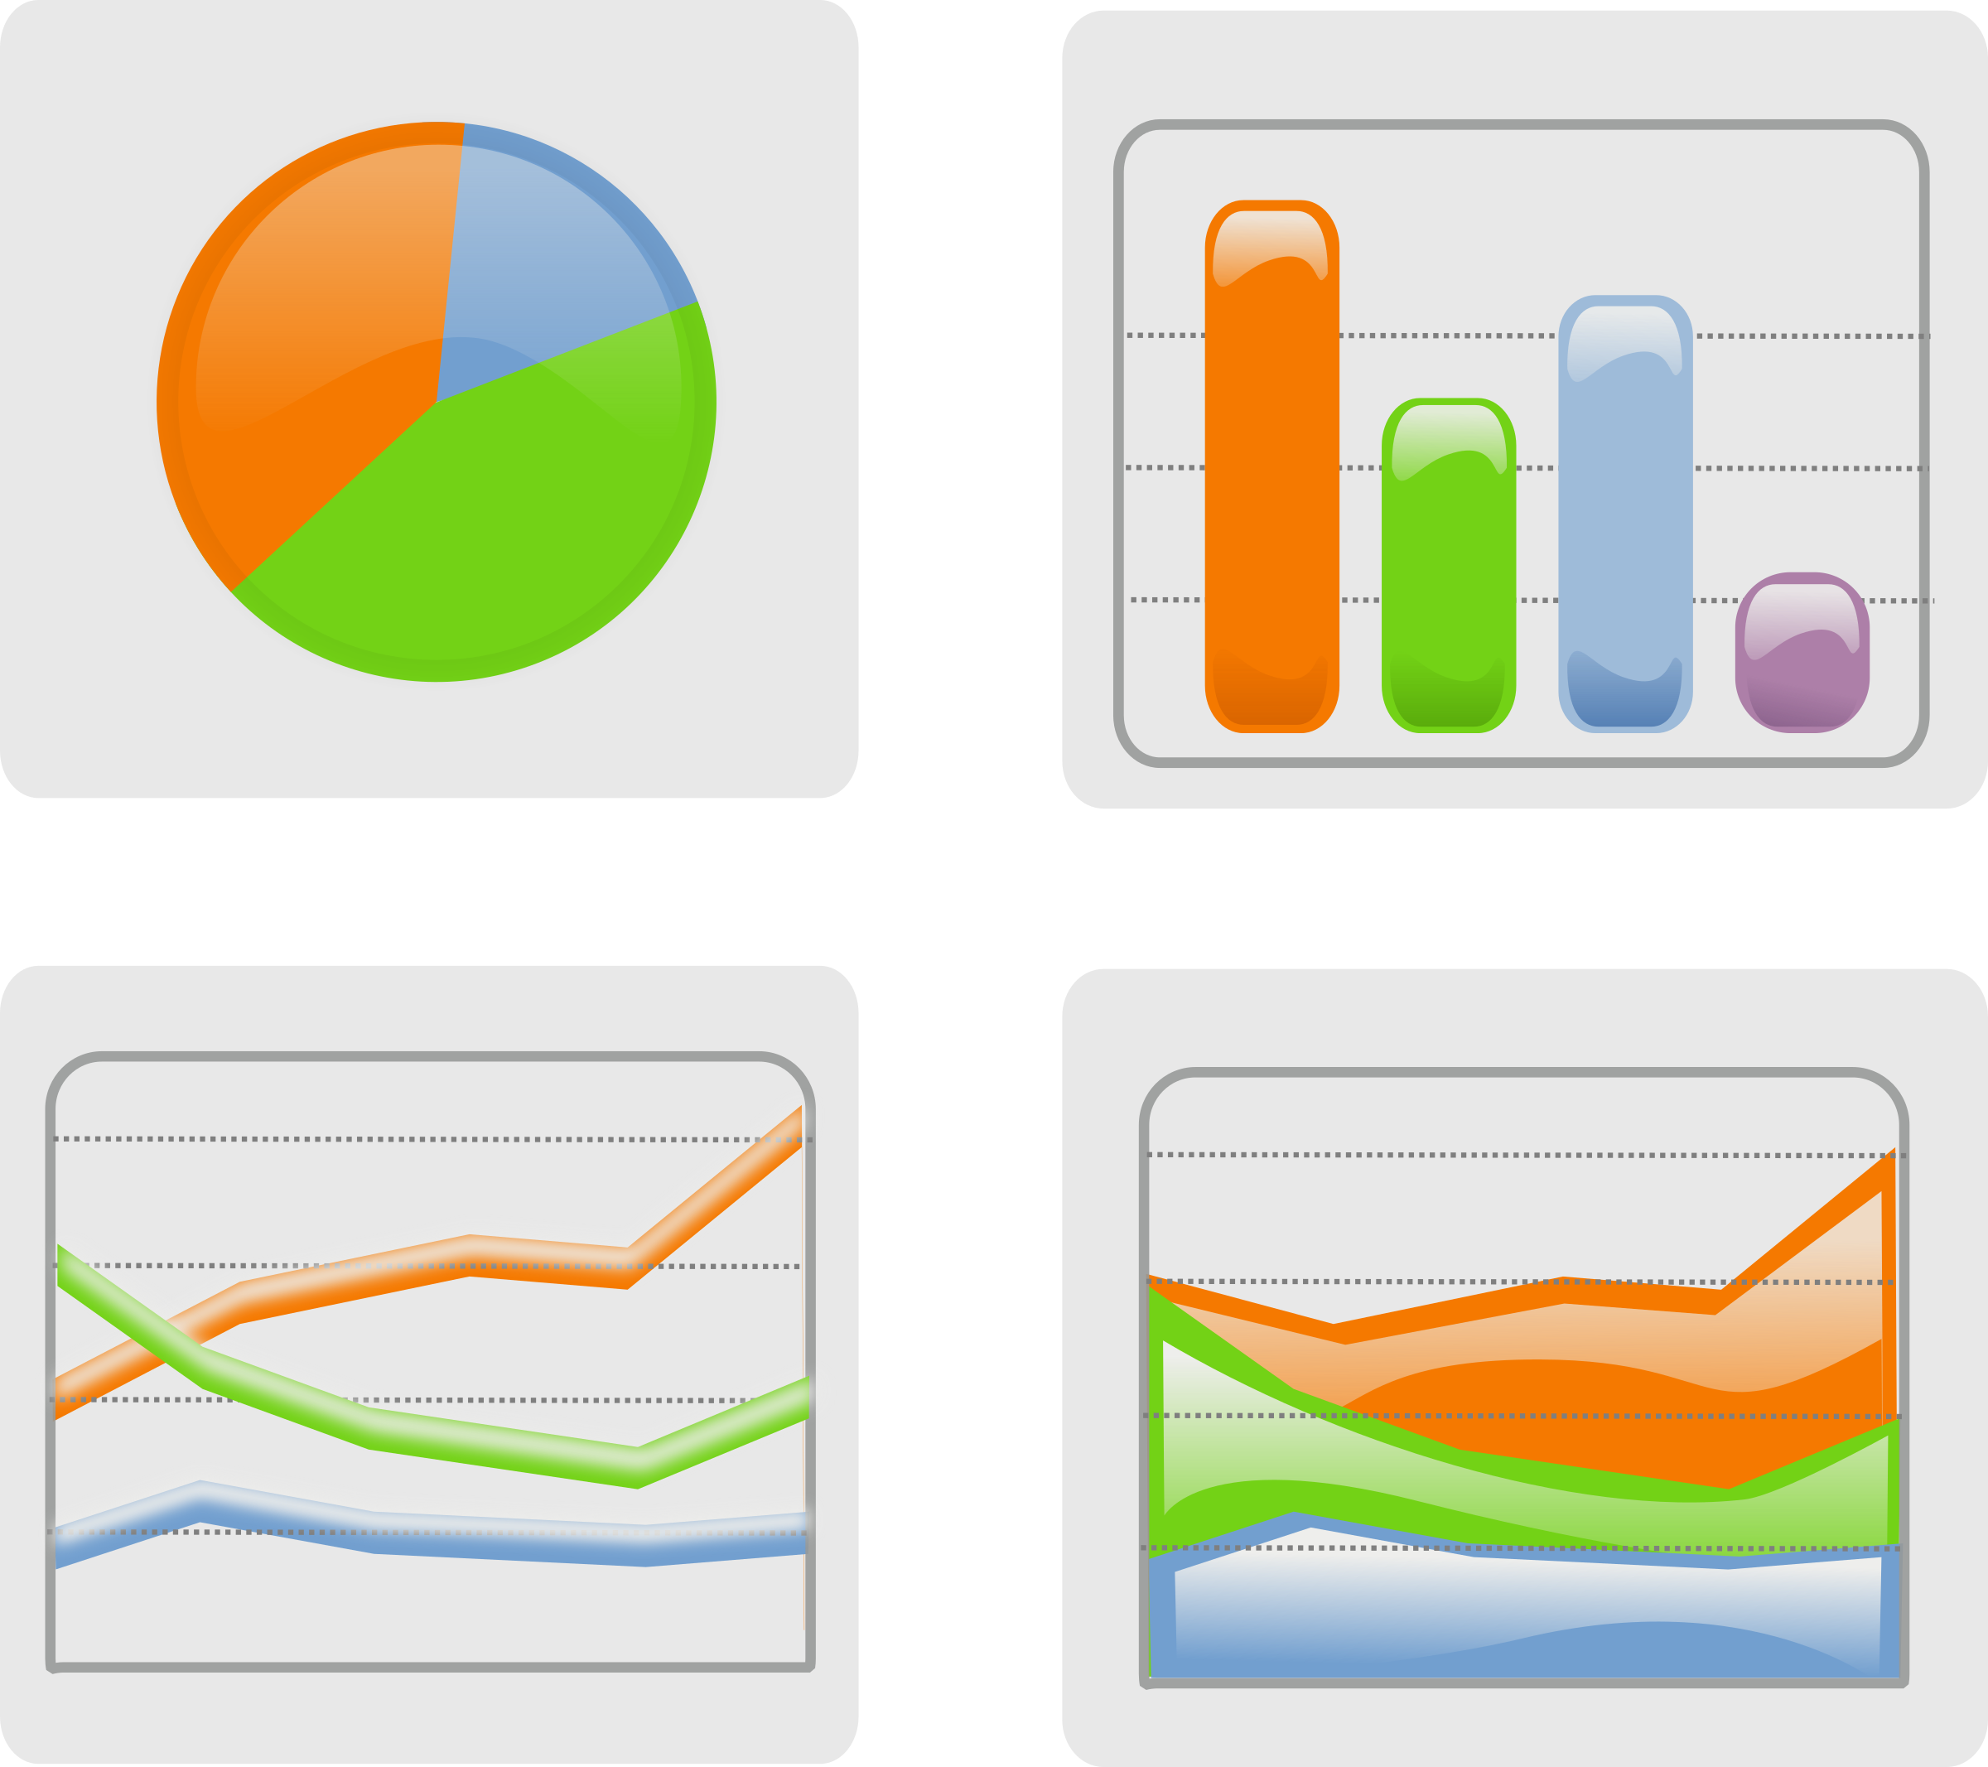

Yes, but it doesn’t work like that…
Log files
USers
Telemetry
Notes:
Talk to the users
Watch the users (they don’t always actually do what they say they do)
Too often have to resort to looking a text by logs, (or guessing – crystal ball)
Can do much better, proper telemetry
Logging without context is noise
Learn what really occurs

Slide 13
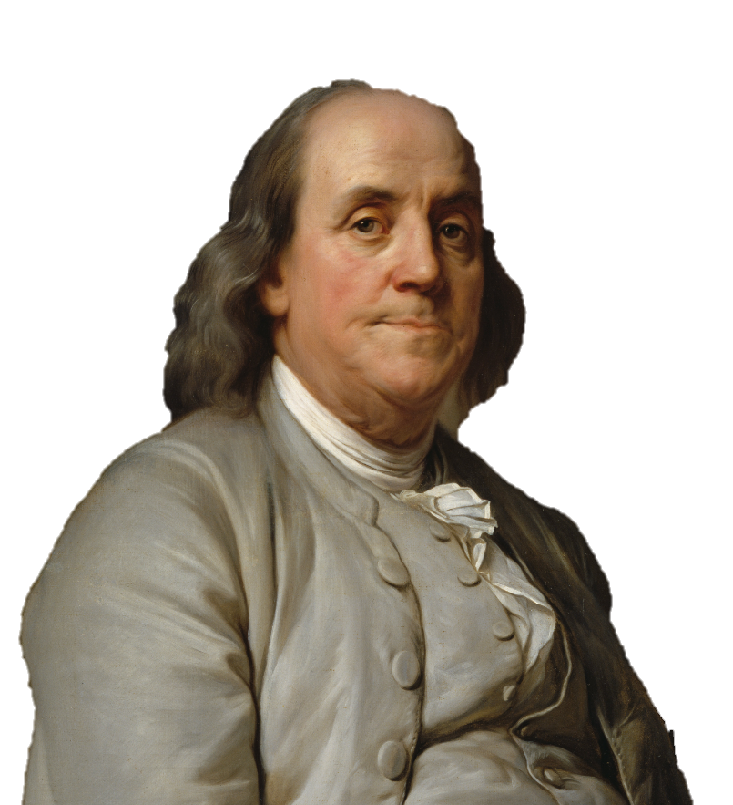
By failing to prepare, you are preparing to fail.
Benjamin Franklin Joseph_Siffrein_Duplessis_-_Benjamin_Franklin_-_Google_Art_Project.jpg (6396×7801) (wikimedia.org)
Notes:
Invest in good telemetry for inevitable issues
Make investment in logging with context
Need unique ids that allow tracing
Modular systems that can be tested independently
Need to move to external logging
Learn what healthy looks like
Set alerts – and act on them – make sure they are not noise

Slide 14
Is Testing part of the solution?
Testing verifies what it does, not how it does it
Use experimentation to create new knowledge
Notes:
Testing is Verification over validation that it works over how it work
Testing only part of the solution
Need to explore the unknown
Experimentation to create new knowledge
Introduce faults as a learning
For cloud scenarios we too often assume resource are infinite, with no delays, topology dies no change – they are not
Chaos engineering
Experimentation
Confidence
Conditions in Production
Can
Test assumptions – stops the guessing (for different roles)
Formulate mitigations
(651) Embrace chaos to achieve stability - René van Osnabrugge - NDC Porto 2022 - YouTube

Slide 15
Embrace your inner Explorer
What happens if I go down that path?
Notes:
Testing is Verification over validation that it works over how it work
Testing only part of the solution
Need to explore the unknown
Experimentation to create new knowledge
Introduce faults as a learning
For cloud scenarios we too often assume resource are infinite, with no delays, topology dies no change – they are not
Chaos engineering
Experimentation
Confidence
Conditions in Production
Can
Test assumptions – stops the guessing (for different roles)
Formulate mitigations
(651) Embrace chaos to achieve stability - René van Osnabrugge - NDC Porto 2022 - YouTube

Slide 16

Just try one thing at a time!
Form a Hypothesis
Test the result
Make One Change
Notes:
The testing process can be summed up as

Slide 17

It is never to early to start to write up
As a ….
Record of what you tried
For audit
To aid a future retrospective
Way to clear your head
Notes:
A form of rubber duck (also good approach)
Introduce blame less retrospectives

Slide 18
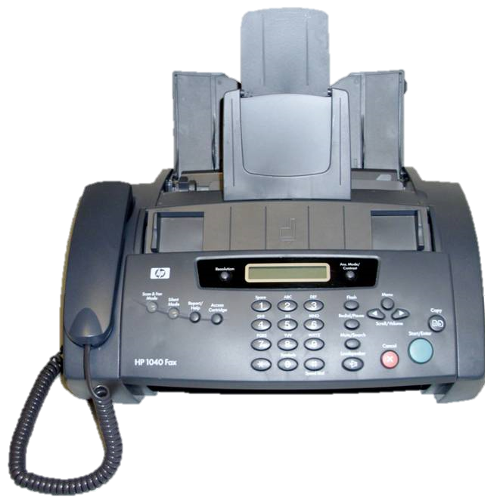
Notes:
Story – fax in your question – a form of rubber duck - often fixes problem

Slide 19

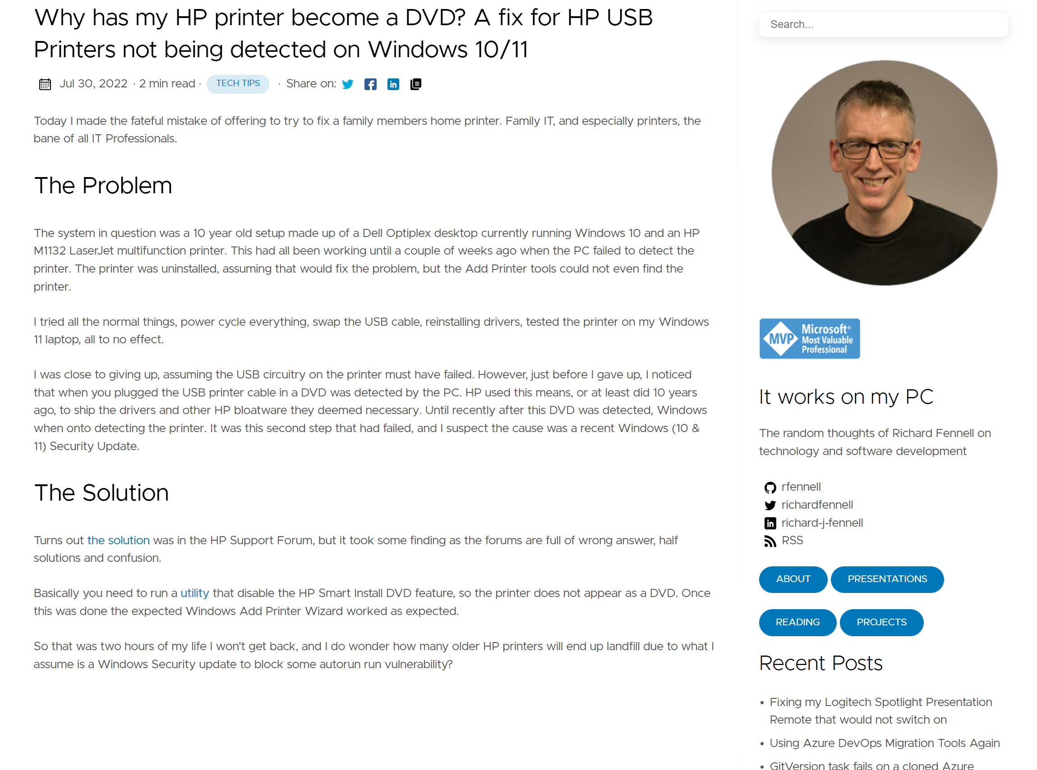
Notes:
Your blog – start the write up early
Your future self will thank you

Slide 20
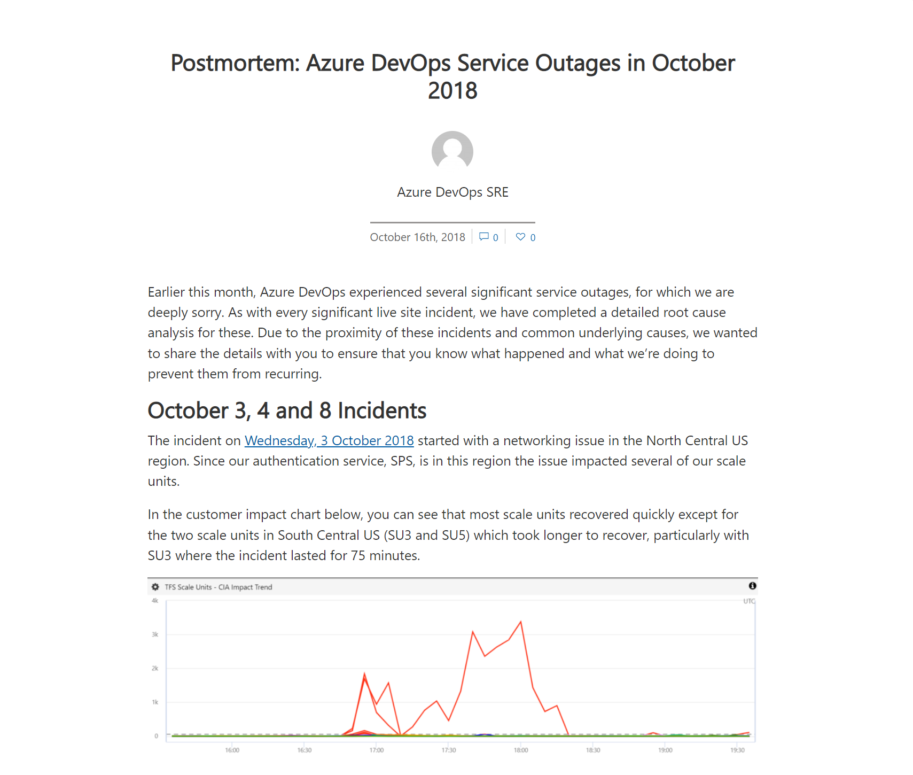
Notes:
Azure DevOps root cause analysis good examples
Give customers confidence

Slide 21
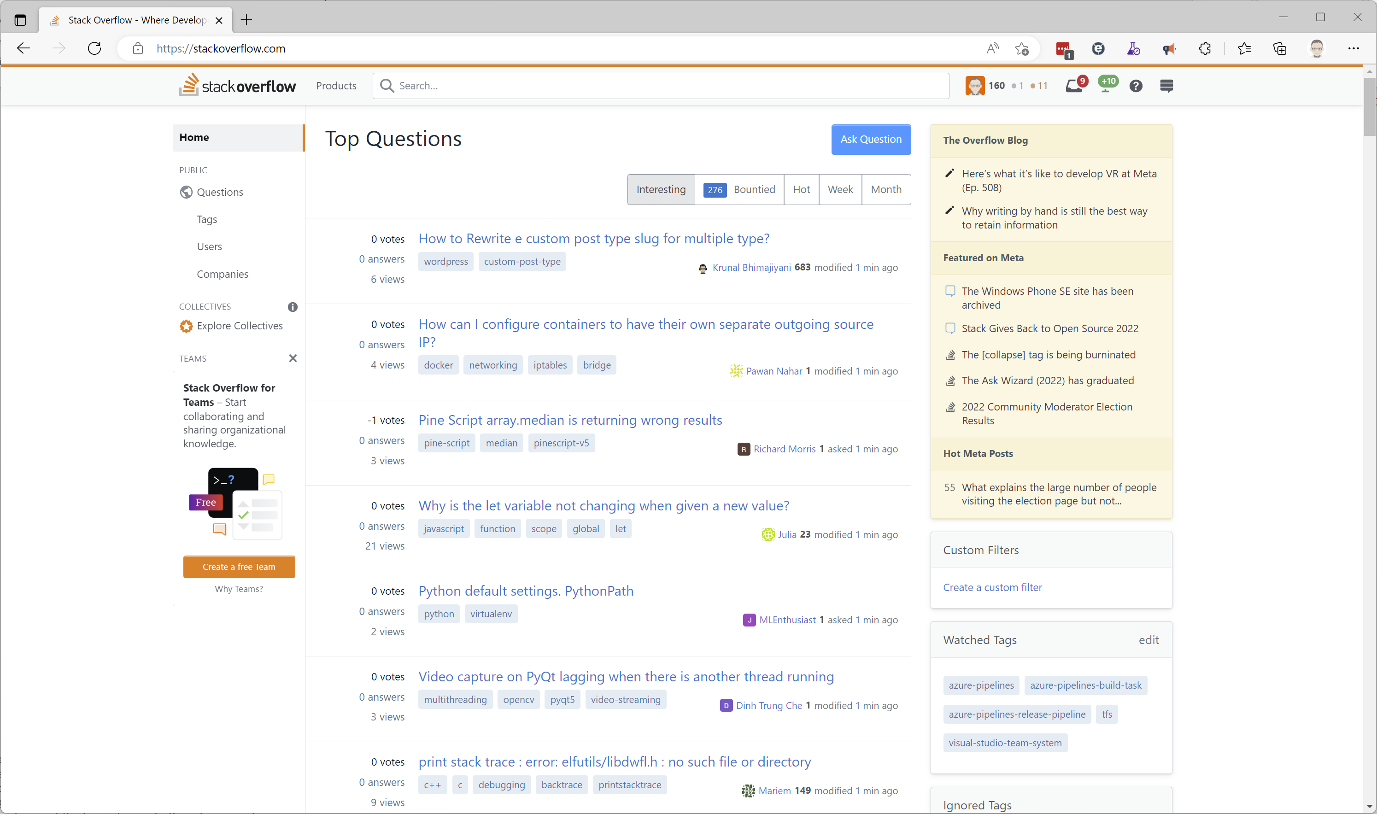
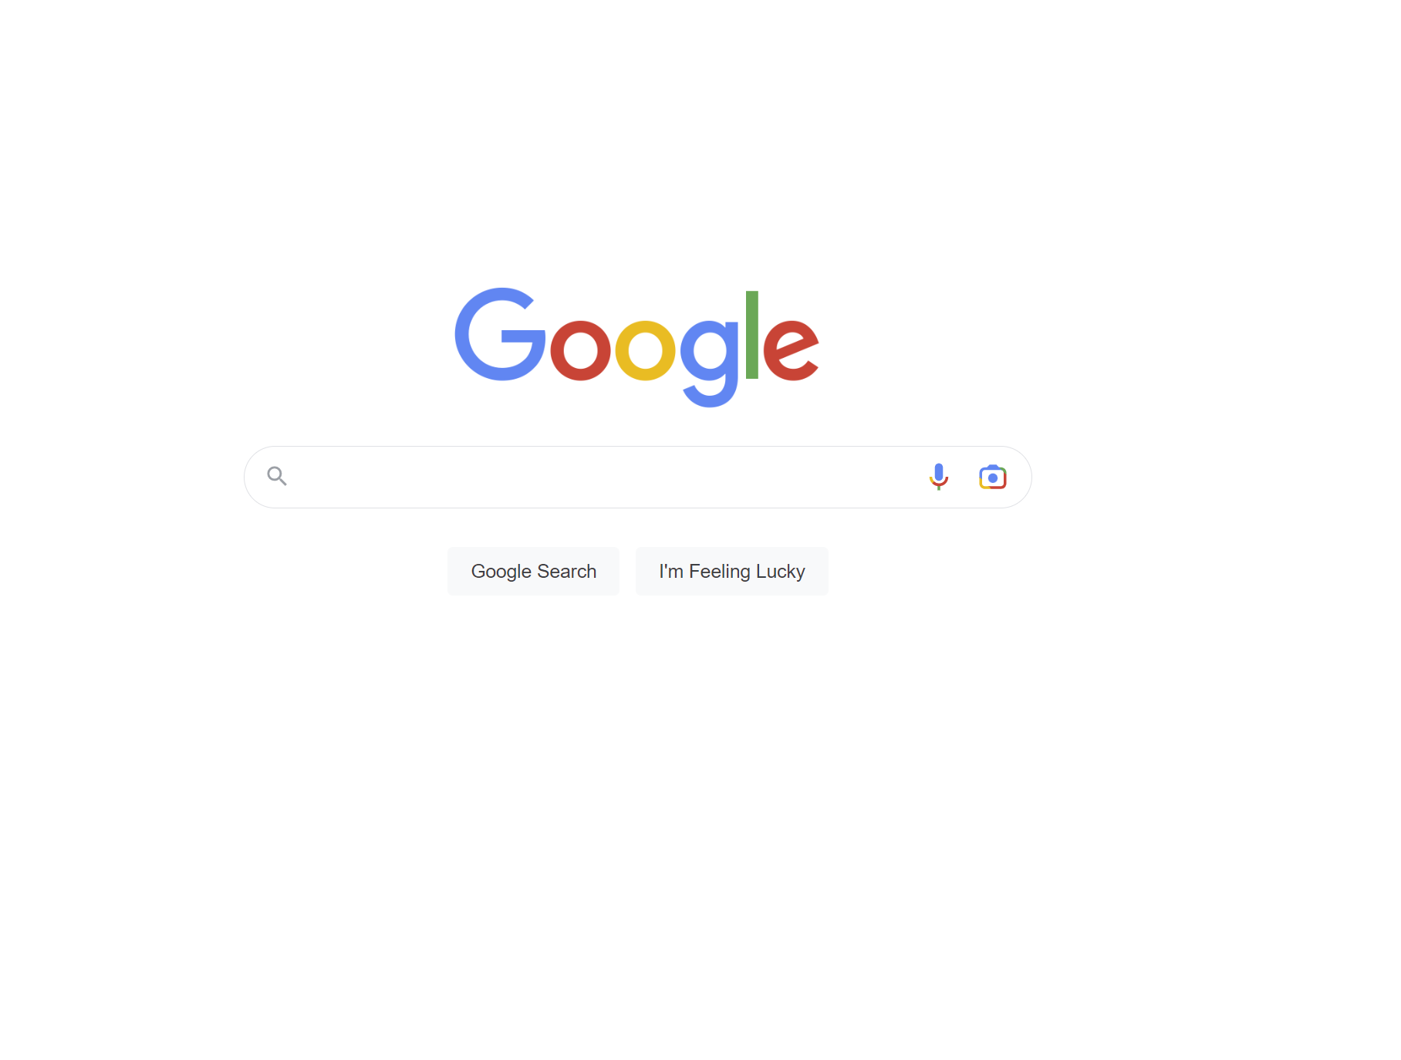
Notes:
- You are probably not the first to have a problem
Google foo skills are important
- Related to real cause
- AzDo top error wrong, dig to get to the lowest, earliest
- Keep reading past the top entries, into thread comments

Slide 22
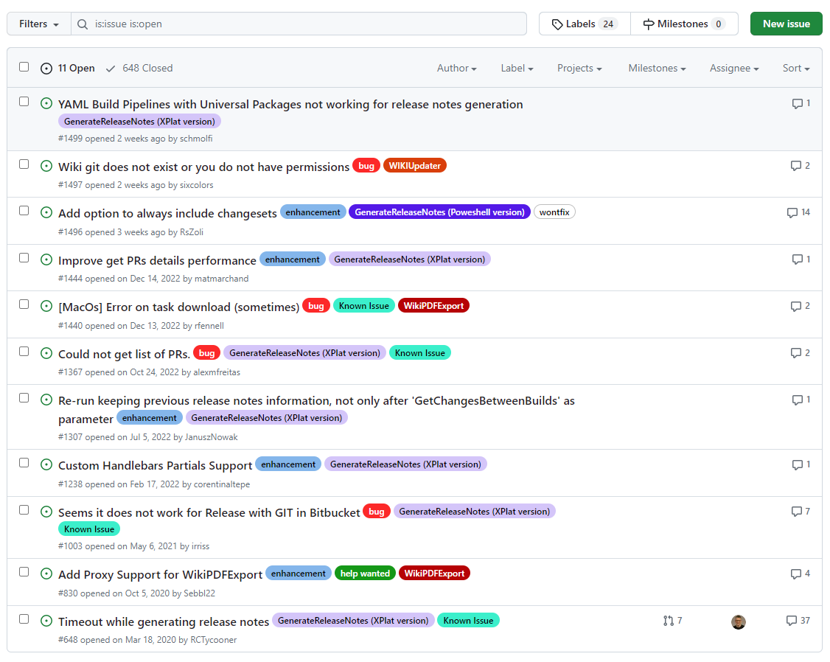
Notes:
- If the issue in OSS check the project repo
GH issues & discussion are a great source,
But not well indexed by search engines - use GH search
Join the conversation – if you have a answer for something provide it

Slide 23
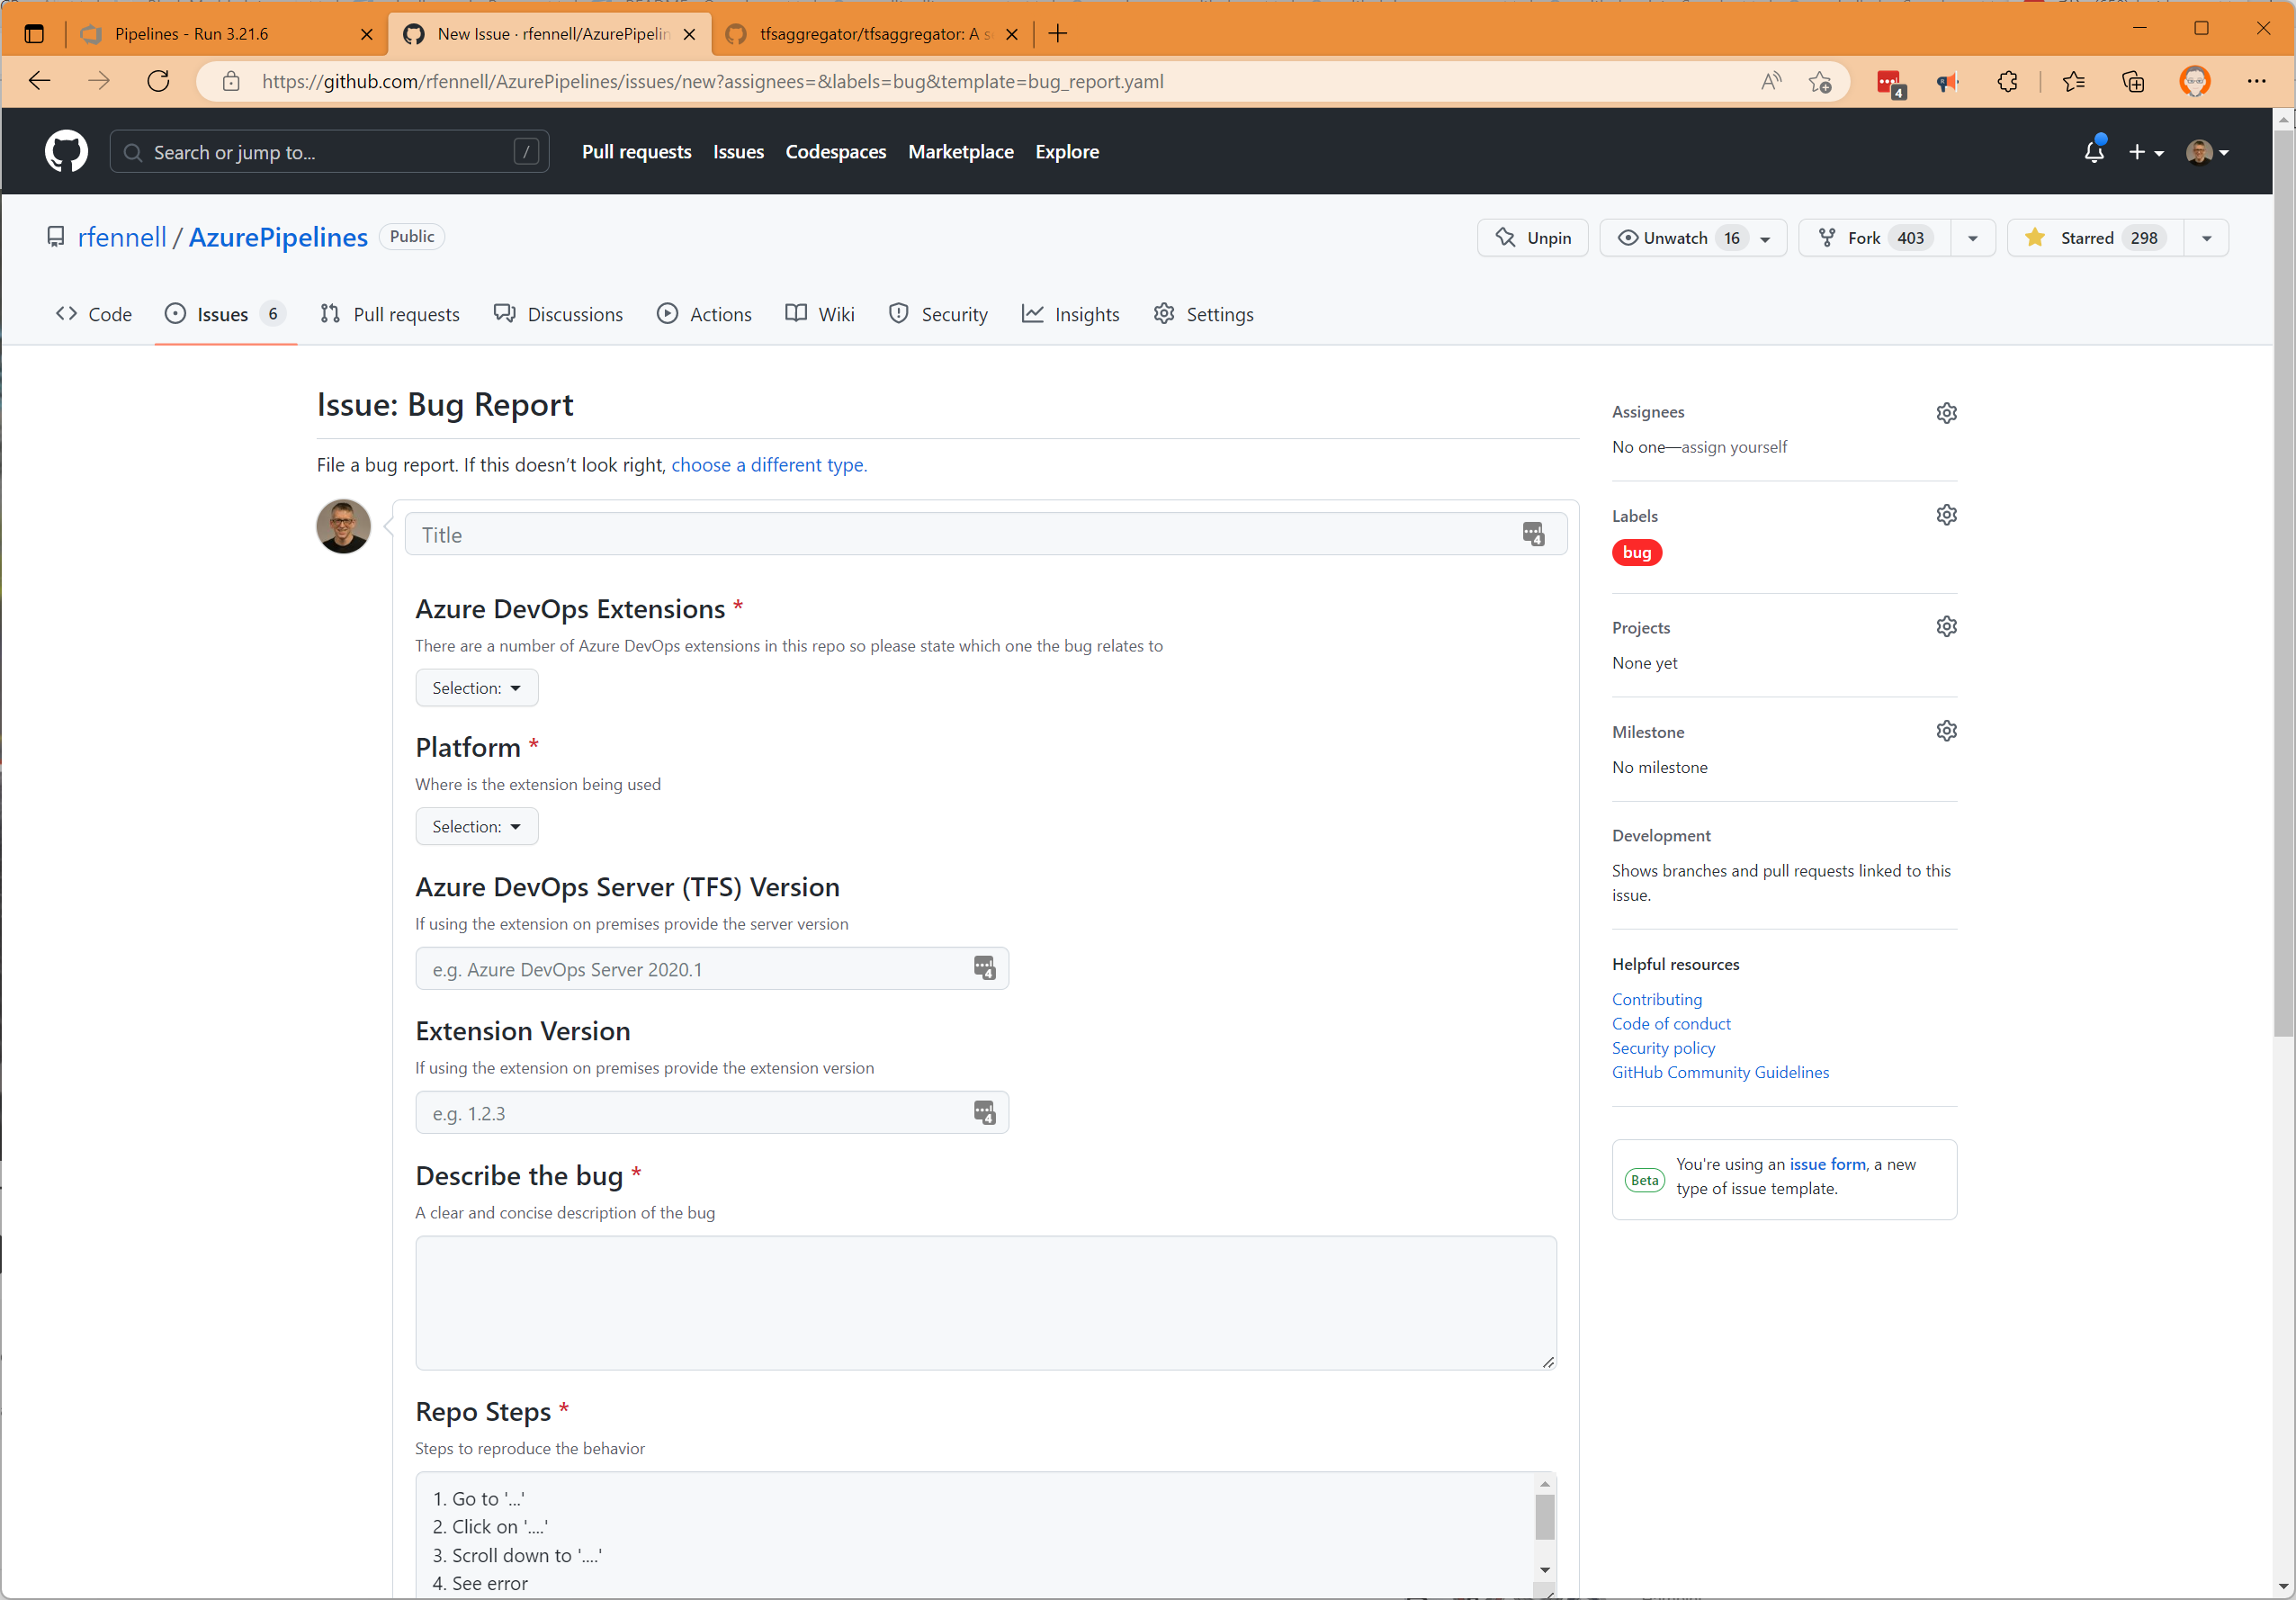

Be nice, maintainers are real people too
Notes:
Ask good question, some locations force a format to ‘help you’
Reflect back on fax story
Ask is the information there to allow someone to help – another rubber duck

Slide 24
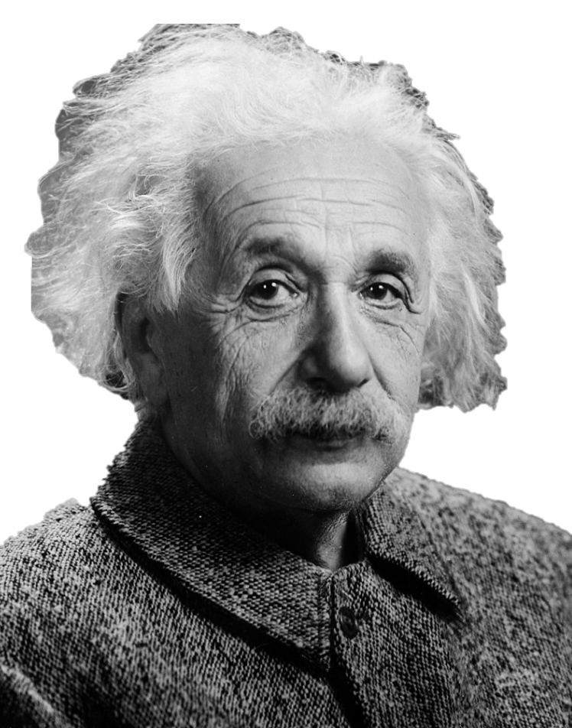
Insanity: doing the same thing over and over again and expecting different results
Albert Einstein https://commons.wikimedia.org/wiki/Category:Albert_Einstein#/media/File:Albert_Einstein_Head.jpg
Notes:
Learn more from mistake
Blameless retrosects (not beating yourself up) – we all have the ‘I deleted prod’ story – right of passage
Reflective learning, and do learn

Slide 25
Summing up…
No such things a dumb question
Experiment – embrace your inner toddler
Your rubber duck is your friend
Never trust your memory
Hold, document and act on actionable blameless retrospectives
Only experience enables the ‘I have never seen it before, but it is a bit like that’ moment, so practice your skills, to grow your knowledge base.
But remember …..
Notes:
Any problem solving skills you have are rooted in basic learning – depth not breadth
No such things a dumb question
Rubber Duck
That said never trust memory, writing things down, your future self will thank
Only experience enables the ‘I have never seen it before but it is a bit like that’ moment
So practice your skills, grow your knowledge

Slide 26
It is always DNS

Slide 27
Richard Fennell
Chief Technology Officer (Black Marble)
MVP (Developer Technologies)
FBCS CEng (BCS)
@RichardFennell

Slide 28

Feel free to use these in your presentation!

Slide 29
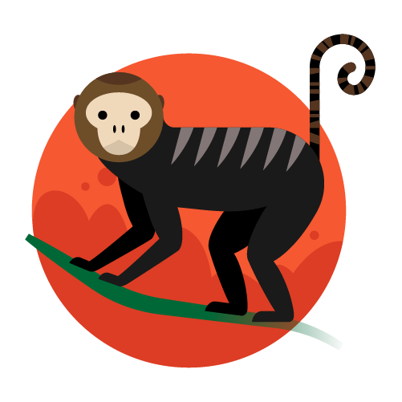


Slide 30




Slide 31







